Slide 1
Vrinda Store Sales and Transaction Data Overview
amreshkumar08797@gmail.com / Amresh Kumar

Slide 2
About the dataset
Relevant inquiries

Slide 3
About the dataset

Slide 4
About the dataset
The Vrinda Store project includes a primary dataset with 31,047 transactions and a supplementary video link dataset. Key insights: customer ages range from 18 to 78 with an average of 39.5 years; transaction amounts average 682 INR. Data cleaning is needed for `Gender` and `Qty` columns. The focus is on direct-to-consumer sales, mainly to female customers.

Slide 5
Relevant inquiries

Slide 6
Monthly sales trend and growth
Sales Performance 2022: Sales peaked in March at 1,928,066 and hit a low in November at 1,615,356, with a 16.2% decrease from March to November. A slight recovery was noted in December.
Data Limitation: Year-over-Year growth cannot be determined due to the absence of prior year data.

Slide 7
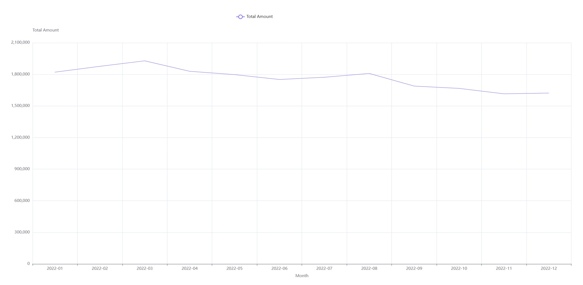

Slide 8
Top Channel for Sales Volume
Dominant Channel: Amazon leads in sales, achieving the highest total amount of 7,519,933 and the highest total quantity of 11,075.
Visual Confirmation: A bar chart confirms Amazon's dominance with the largest bar for total sales amount.

Slide 9
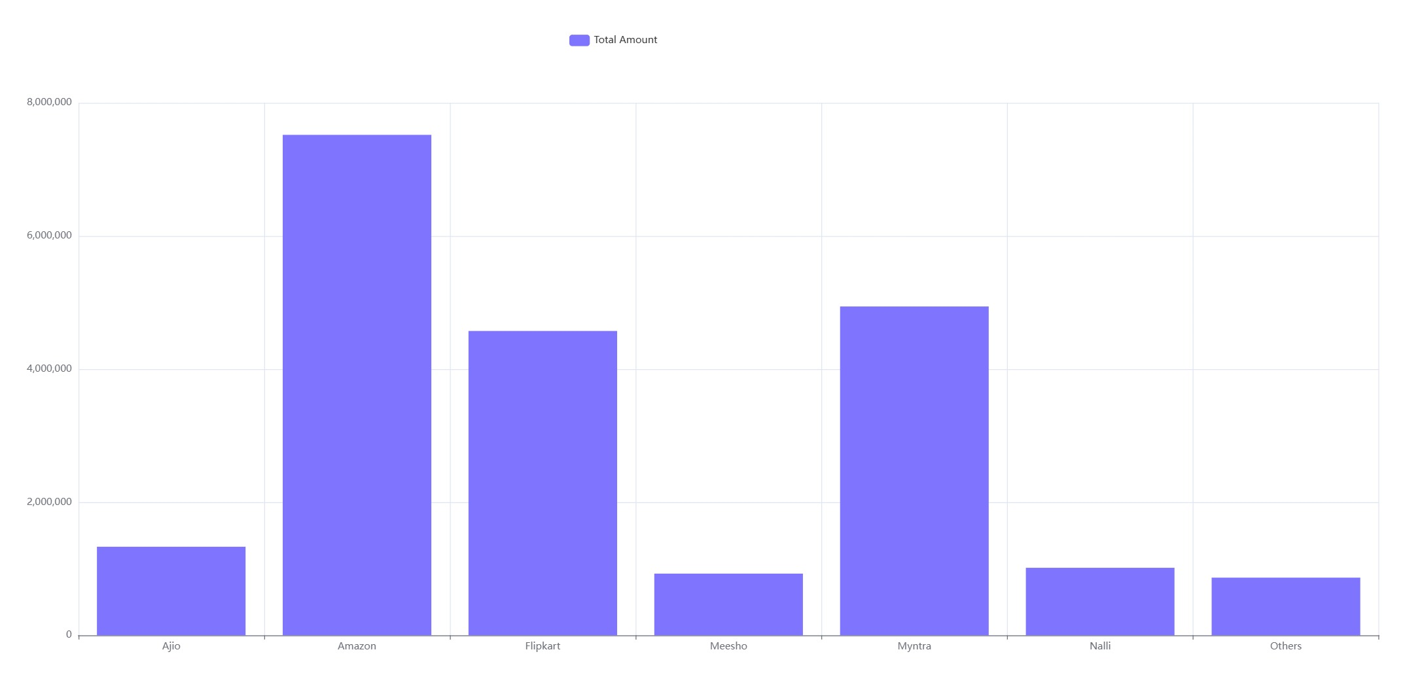

Slide 10
Top 5 Categories by Sales
Dominant Category: The 'Set' category leads with a total amount of 10,507,546 and quantity of 12,446, more than double the second-ranked 'kurta'.
Correlation: A strong positive correlation exists between total amount and quantity sold.
Performance Disparity: Significant drop-off from top two categories to others, indicating lower market demand.

Slide 11
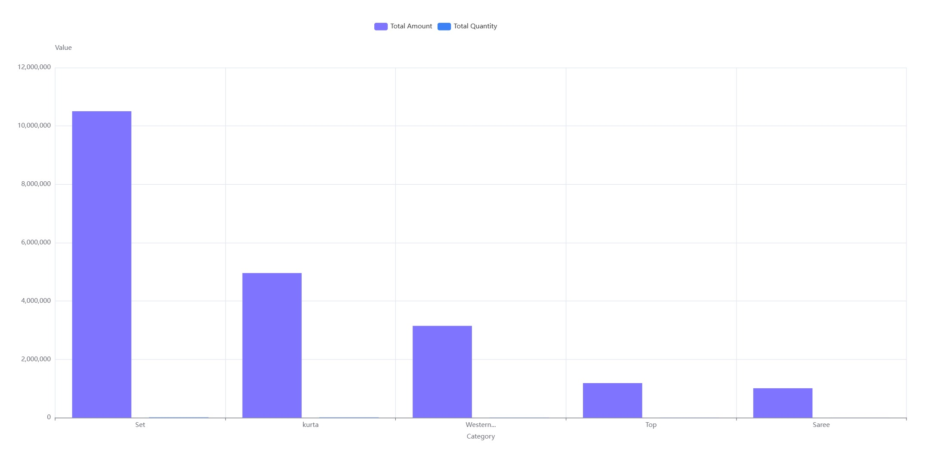

Slide 12
Amount variation by Age, Gender
Gender-Based Spending Disparity: Women generally spend significantly more than men, with peaks in spending at ages 23-24 and 33-34.
Age-Related Decline: Spending decreases with age, especially after 50 years.
Marketing Opportunities: Focus on high-spending female demographics and explore strategies to boost spending in other groups.

Slide 13
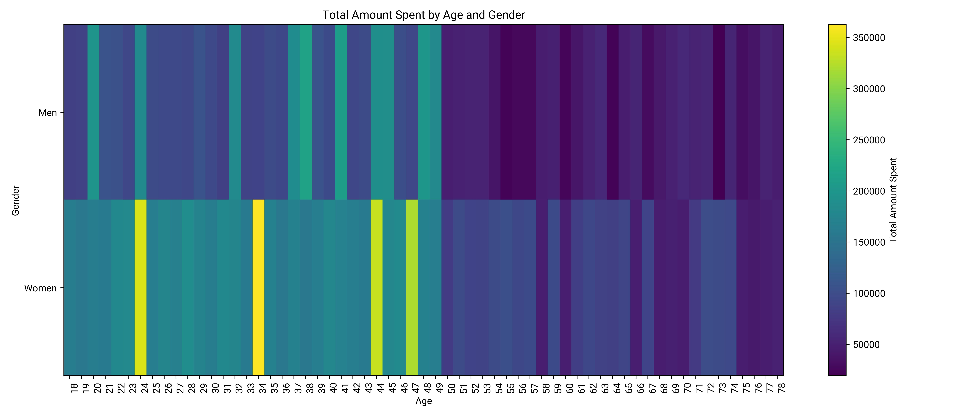

Slide 14
Detect spikes in cancellation rate
Monthly Cancellation Rates: Ranged from 2.14% to 3.48% in 2022, averaging 2.72%.
No Unusual Spikes: Analysis using Tukey's fences method found no outliers in cancellation rates.
Stable Performance: Consistent rates indicate a stable order cancellation performance throughout the year, providing a baseline for future monitoring.

Slide 15
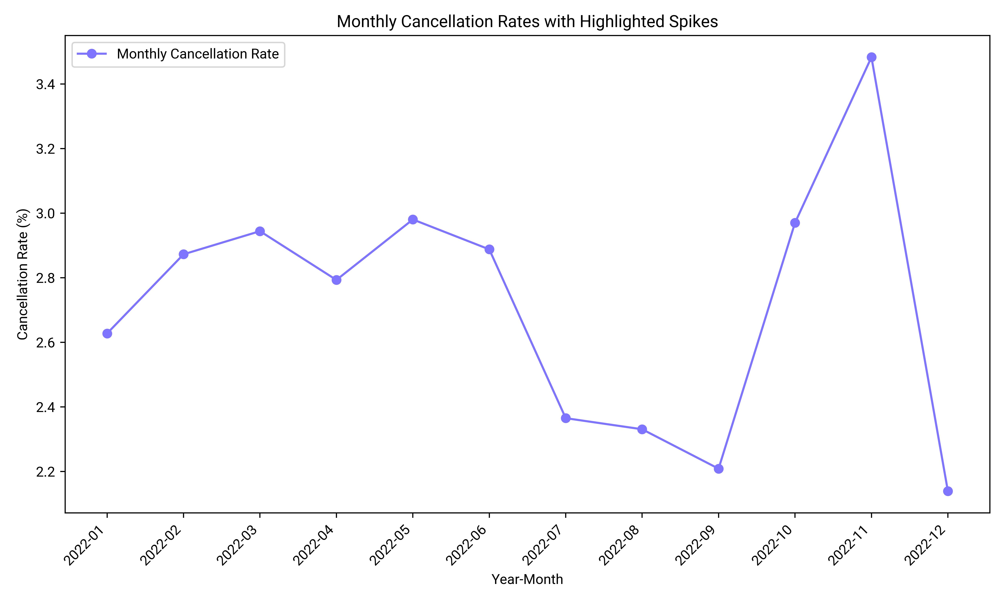

Slide 16
Top `ship-state` by `Amount`
MAHARASHTRA leads in both total amount (2,990,221) and unique orders (4,442), showing its dominance in sales and customer engagement.
KARNATAKA and UTTAR PRADESH follow as top contributors in both categories, indicating a strong correlation between high sales volume and unique orders.

Slide 17
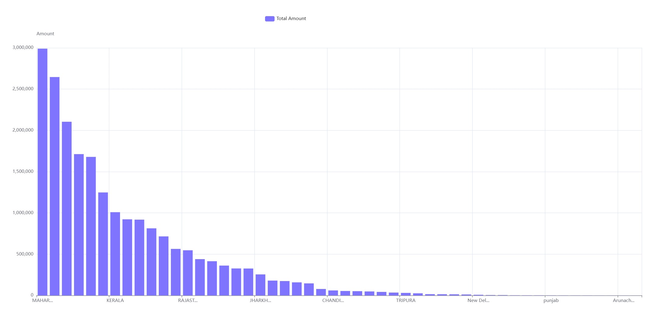

Slide 18
Average Amount by Size Category
Highest and Lowest Averages: 5XL has the highest average amount at 739.37, while XXL has the lowest at 658.71.
Range and Trends: Average amounts range from 658.71 to 739.37. Larger sizes like 5XL, 6XL, and Free have higher averages, while smaller sizes vary.
Visual Confirmation: A bar chart illustrates these averages, with sizes on the x-axis and amounts on the y-axis.

Slide 19
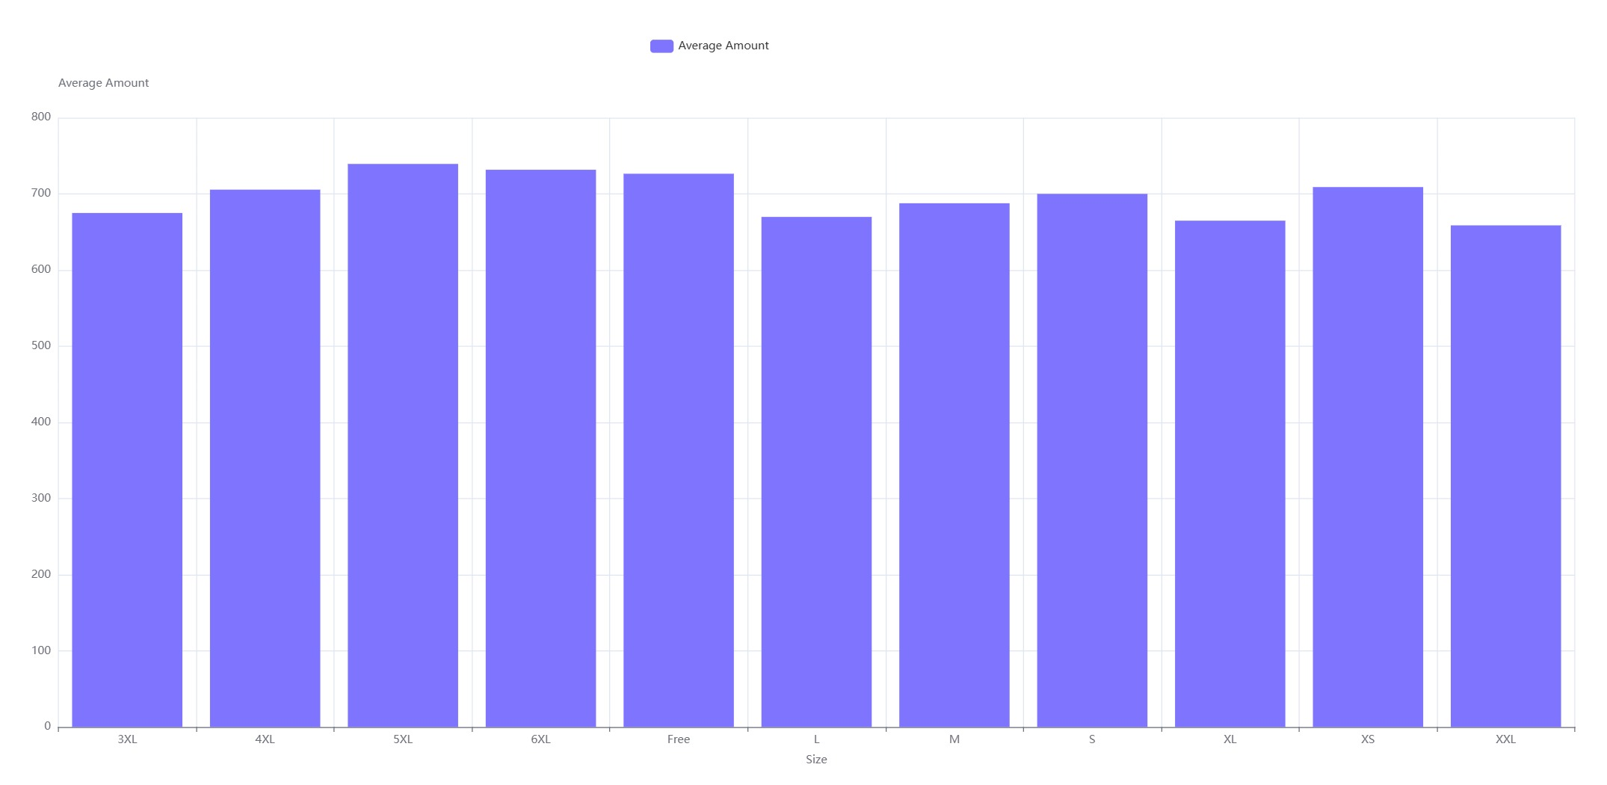

Slide 20
Daily Order ID Trend Analysis
Daily Order Volatility: Average daily orders are 790.86, with a range from 623 to 1071 and a standard deviation of 110.29, indicating high variability.
7-day Moving Average Stability: The average is 798.57, with a range of 698.86 to 882.0 and a lower standard deviation of 42.53, smoothing daily fluctuations.
Trend Insights: The 7-day moving average reveals stable order volume around 800 with seasonal patterns and a slight decline at year-end.

Slide 21
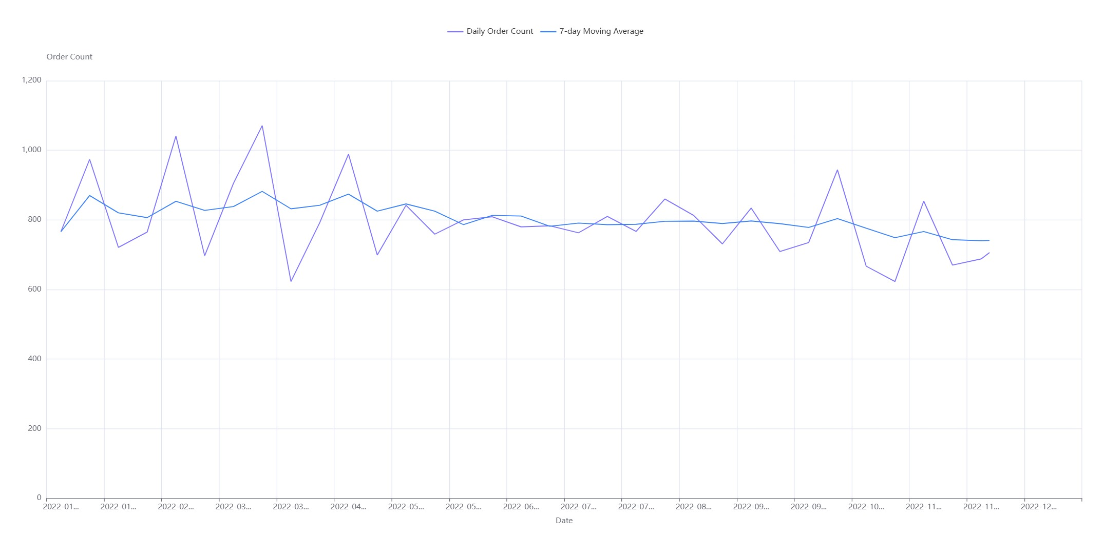

Slide 22
Compare B2B vs non-B2B orders
Non-B2B Dominance: Non-B2B orders significantly surpass B2B in both total amount (21,050,056 vs. 126,321) and quantity (31,048 vs. 189).
Strategic Insight: The business is primarily driven by non-B2B transactions, indicating a focus on individual consumers over business clients.

Slide 23
Status Distribution by Channel
Dominance of Delivered Orders: Delivered orders significantly outnumber cancelled and returned orders across all channels.
Amazon's High Volume: Amazon leads with the highest order counts, especially in delivered orders (10,124).
Efficient Order Processing: Low cancellation/return rates suggest efficient processing and customer satisfaction across channels.

Slide 24
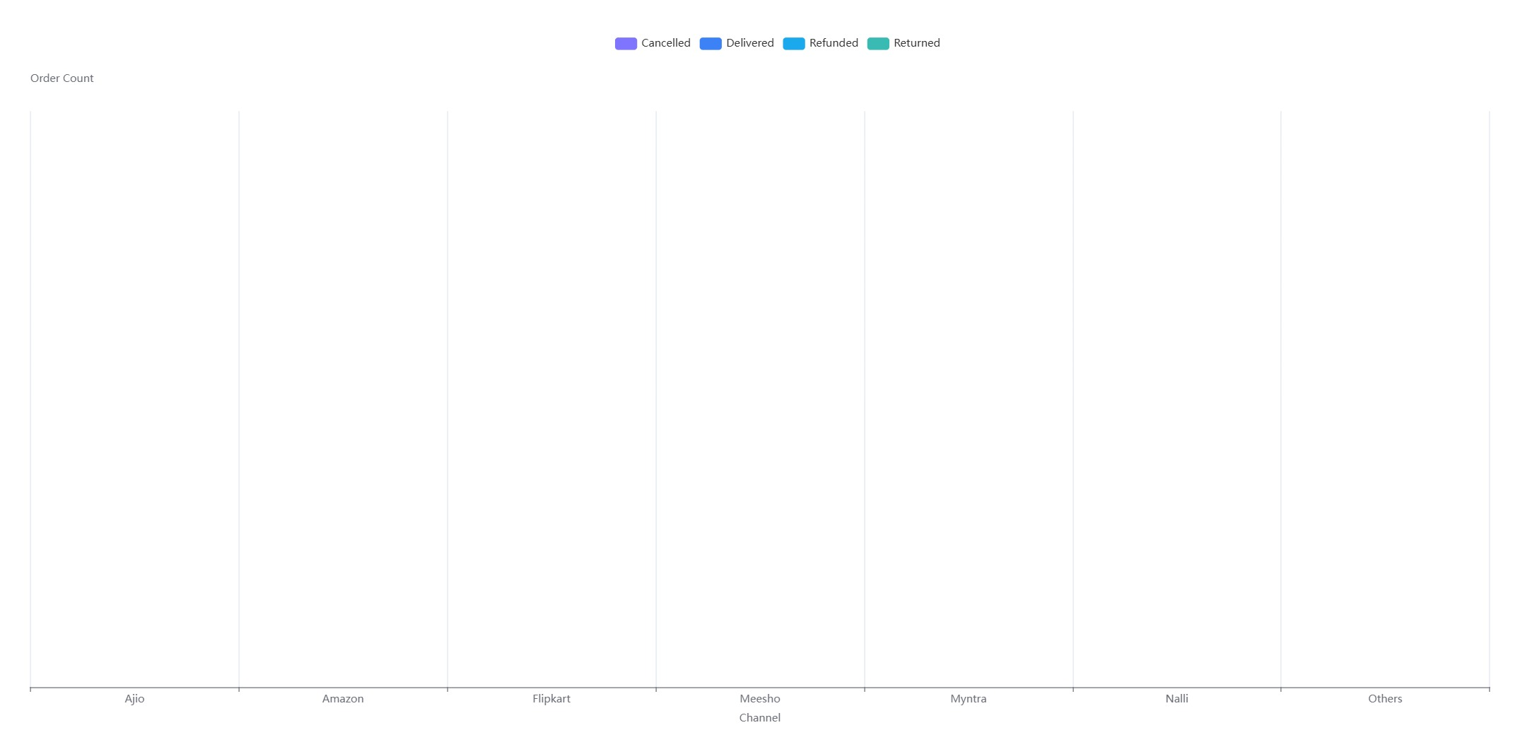

Slide 25
amreshkumar08797@gmail.com / Amresh Kumar

